Slide 1
Entrepreneurship Development

Slide 2
Product Positioning
Why is product positioning important?
Each brand has to know its customers to provide a product that resonates with their needs. A well-thought-out strategy can determine the position of this product within the market and identify its benefits for consumers.
The process involves creating a particular image of a brand and its products in consumers’ minds and identifying the key benefits to show how a particular product differs from competitors’ alternatives. Afterward, the difference is communicated to a brand’s target audience through the most effective communication channels. The messages brands convey to their customers should evoke interest.
Marketers need to determine the best ways to present specific products and reach their target audience based on customers’ needs, competitive alternatives, the most effective communication channels, and tailored messages. Implementing product positioning strategies enables companies to create messages that address their customers’ needs and wants and entice them to purchase.
There are even more pros this type of marketing can bring, so check out our list to know all of them.

Slide 3
Benefits of product positioning
We’ve prepared the top benefits of product positioning that show why it’s one of the most effective marketing tactics. It helps in:
identifying key benefits of a product and matching them with customers’ needs;
finding a competitive advantage even when the market changes;
meeting customers’ expectations;
reinforcing your brand’s name and its products;
winning customer loyalty;
creating an effective promotional strategy;
attracting different customers;
improving competitive strength;
launching new products;
presenting new features of existing products.
Now that you know the advantages, we’ll move to the next section to review product positioning strategies.

Slide 4
Product Positioning Strategies
Characteristics-based positioning
Pricing-based positioning
Use or application-based positioning
Quality or prestige-based positioning
Competitor-based positioning
Characteristics-based positioning. Brands give certain characteristics to their products that aim at creating associations. It’s done to make consumers choose based on brand image and product characteristics. Let’s take the automobile industry, for example. A person who worries about safety will probably choose Volvo because of the brand’s positioning. At the same time, another customer who pays attention to reliability would prefer Toyota.

Slide 5
Product Positioning Strategies
Pricing-based positioning. This strategy involves associating your company with competitive pricing. Brands often position themselves as those that offer products or services at the lowest price. Let’s take supermarkets, for example. They can afford to provide customers with products for lower prices because of the lower costs they pay for shipping and distribution, huge turnover, and a large procurement of goods. As a result, many consumers already know the supermarkets with attractive prices and choose them without considering other options.
Use or application-based positioning. Companies can also position themselves by associating with a certain use or application. People who adhere to a healthy lifestyle create a great demand for products that help increase performance in the gym. Hence, many businesses offer nutritional supplements. These brands sell supplements that are high in calories, vitamins, and minerals.
Quality or prestige-based positioning. The brands we are talking about now don’t concentrate on their price point; they focus on their prestige or high quality instead. Sometimes, it’s the reputation that makes a brand attract customers. Let’s take Rolex, for example. This famous watch brand is associated with achievement and excellence in sport and is popular among powerful and wealthy people.
Competitor-based positioning. The strategy involves using competitors’ alternatives to differentiate products and highlight their advantages. It helps brands distinguish their products and show their uniqueness.
The difference is clear now, so it’s time to jump to the steps required for successful product positioning.

Slide 6
Steps to Position Your Product
Define your target audience
Identify the key benefits of your product
Establish brand credibility
Offer a unique value proposition
Consider audience segmentation
Craft your messaging
Do a competitive analysis
Demonstrate your expertise
Focus on your competitive advantage
Maintain your brand’s position

Slide 7
Steps to Position Your Product
Define your target audience. Knowing your customers' needs, wants, demographics, and interests allows you to give them the product they strive for. This way, you can reach your target audience and motivate them to buy your products. For this purpose, you need to be well-prepared and operate the necessary information.
Identify the key benefits of your product. Benefits are a top priority for any customer who wants to solve a particular problem. As a business owner, you need to know all the peculiarities of your products or services, including their features and advantages. You need to identify your key perks and communicate them to the masses so that they can consider your product when reviewing several options.
Establish brand credibility. You need to create a brand that people can rely on to build trusting relationships and encourage your customers to make repeat purchases. Consumers are more inclined to make repeat purchases from companies with a good reputation and high credibility. Remember not to make promises you can’t keep and claims that can’t be verified. Prioritize honesty and transparency since they will help you build a healthy product positioning strategy.
Offer a unique value proposition. Communicate the value your product can bring to your target audience. You need to be aware of the fact that consumers won’t choose a product if they can’t benefit from it. Explore your product, find its benefits, and search for the most appropriate communication channels to convey them to your leads and customers effectively.

Slide 8
Steps to Position Your Product
Consider audience segmentation. If you want to obtain the best results, you need to segment your audience since your product can’t satisfy all your customers’ needs. You can divide them into groups based on their interests, traits, and needs to create customized messages. As a result, you’ll be able to appeal to their individual wants and needs and provide them with your product as a solution.
Craft your messaging. Once you segment your customers, it’s necessary to select the right communication channels for each group. Some of them might prefer social media platforms, but others might use traditional channels like TV and radio. Give some thought to writing a positioning statement (a description of a product, its target audience, and how this product can solve a problem that arises). It will help you prepare personalized and effective messages that speak to the needs and preferences of each group.
Do a competitive analysis. Once your message is ready, you need to evaluate your competitors’ businesses and the products or services they offer. Competitor research gives you a clear understanding of your rivals, their offers, and what makes your product different in a positive way. Afterward, you’ll be aware of the distinctive features and benefits your product has, your core values, innovations, and various improvements your company provides consumers with.
Demonstrate your expertise. Explain to your customers why they should choose you over your competitors. You should also prove that your product is better and that it has several benefits useful for consumers. There are several ways to show the quality of your product or its benefits: testing, trials, demonstrations, etc.
Focus on your competitive advantage. These are the factors that enable your company to manufacture better or cheaper products and outperform your competitors. You need to speak about the actual benefit your product provides. Customers should truly need this product and obtain its visible value. It also includes staying up-to-date and adapting to new trends and innovations.
Maintain your brand’s position. Once you reach this step, you need to maintain your brand’s position so that customers continue buying your products. If you aim to operate this successfully, you should never compromise on quality and increase or reduce prices drastically since it can make customers suspicious.

Slide 9
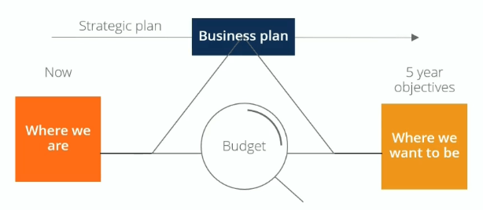
Budgeting
What is Budgeting?
Budgeting is the tactical implementation of a business plan. To achieve the goals in a business’s strategic plan, we need a detailed descriptive roadmap of the business plan that sets measures and indicators of performance. We can then make changes along the way to ensure that we arrive at the desired goals.

Slide 10
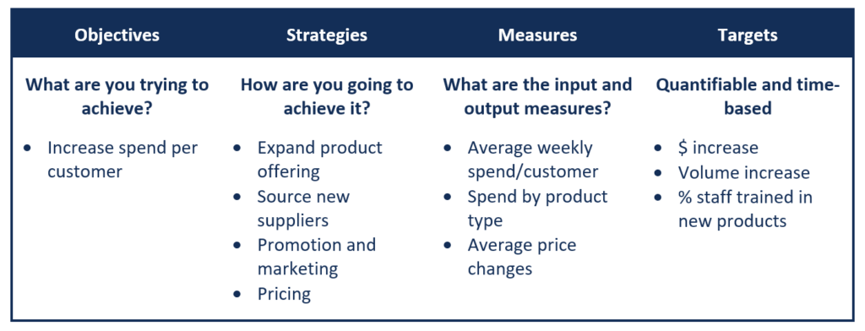
Translating Strategy into Targets and Budgets
There are four dimensions to consider when translating high-level strategy, such as mission, vision, and goals, into budgets.

Slide 11
Goals of the Budgeting Process
1. Aids in the planning of actual operations
The process gets managers to consider how conditions may change and what steps they need to take, while also allowing managers to understand how to address problems when they arise.
2. Coordinates the activities of the organization
Budgeting encourages managers to build relationships with the other parts of the operation and understand how the various departments and teams interact with each other and how they all support the overall organization.
3. Communicating plans to various managers
Communicating plans to managers is an important social aspect of the process, which ensures that everyone gets a clear understanding of how they support the organization. It encourages communication of individual goals, plans, and initiatives, which all roll up together to support the growth of the business. It also ensures appropriate individuals are made accountable for implementing the budget.
4. Motivates managers to strive to achieve the budget goals
Budgeting gets managers to focus on participation in the budget process. It provides a challenge or target for individuals and managers by linking their compensation and performance relative to the budget.
5. Control activities : Managers can compare actual spending with the budget to control financial activities.
6. Evaluate the performance of managers
Budgeting provides a means of informing managers of how well they are performing in meeting targets they have set.

Slide 12
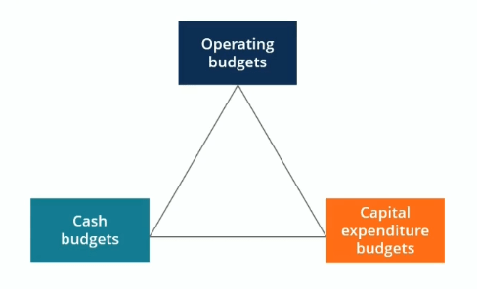
Types of Budgets

Slide 13
Types of Budgets
A robust budget framework is built around a master budget consisting of operating budgets, capital expenditure budgets, and cash budgets. The combined budgets generate a budgeted income statement, balance sheet, and cash flow statement.
1. Operating budget
Revenues and associated expenses in day-to-day operations are budgeted in detail and are divided into major categories such as revenues, salaries, benefits, and non-salary expenses.
2. Capital budget
Capital budgets are typically requests for purchases of large assets such as property, equipment, or IT systems that create major demands on an organization’s cash flow. The purposes of capital budgets are to allocate funds, control risks in decision-making, and set priorities.
3. Cash budget
Cash budgets tie the other two budgets together and take into account the timing of payments and the timing of receipt of cash from revenues. Cash budgets help management track and manage the company’s cash flow effectively by assessing whether additional capital is required, whether the company needs to raise money, or if there is excess capital.

Slide 14
Sales Planning
The 7-step sales process
Prospecting
Preparation
Approach
Presentation
Handling objections
Closing
Follow-up

Slide 15
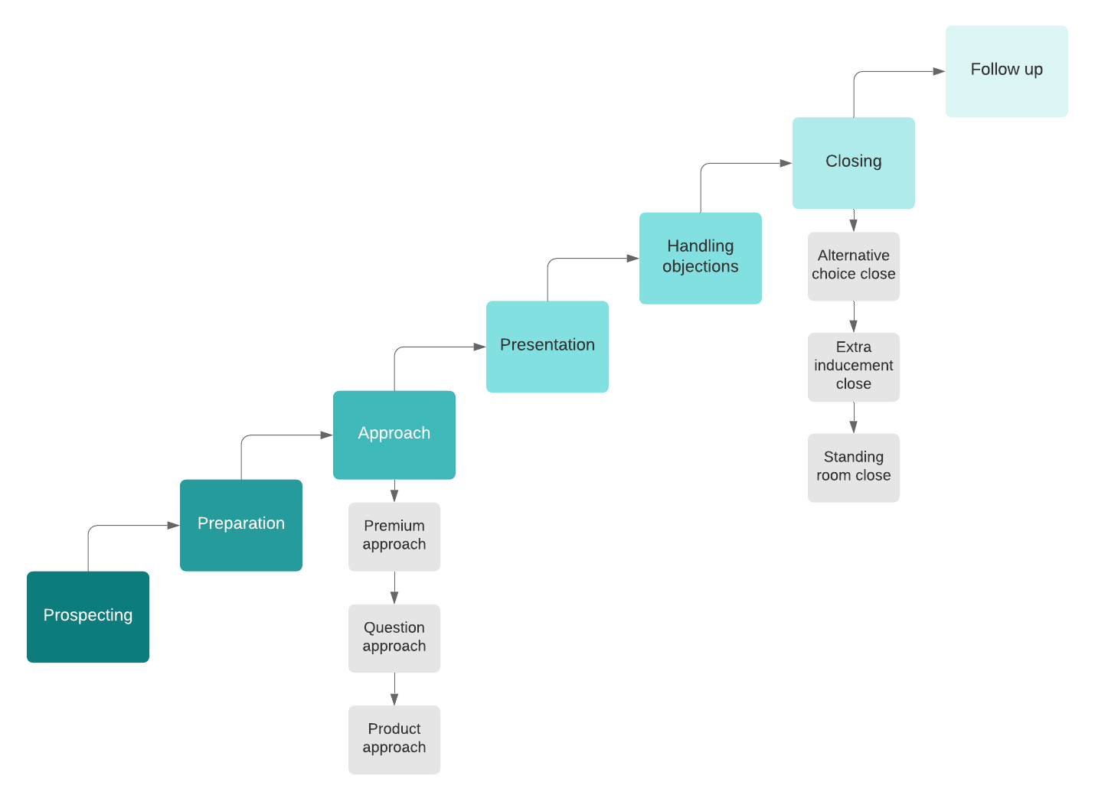
Sales Planning

Slide 16
1. Prospecting
The first step in the sales process is prospecting. In this stage, you find potential customers and determine whether they have a need for your product or service—and whether they can afford what you offer. Evaluating whether the customers need your product or service and can afford it is known as qualifying.
Keep in mind that, in modern sales, it's not enough to find one prospect at a company: There are an average of 6.8 customer stakeholders involved in a typical purchase, so you'll want to practice multi-threading, or connecting with multiple decision-makers on the purchasing side. Account maps are an effective way of identifying these buyers.
2. Preparation
The next step is preparing for initial contact with a potential customer, researching the market and collecting all relevant information regarding your product or service. Develop your sales presentation and tailor it to your potential client’s particular needs. Preparation is key to setting you up for success. The better you understand your prospect and their needs, the better you can address their objections and set yourself apart from the competition.
3. Approach
Next, make first contact with your client. This is called the approach. Sometimes this is a face-to-face meeting, sometimes it’s over the phone. There are three common approach methods.
Premium approach: Presenting your potential client with a gift at the beginning of your interaction
Question approach: Asking a question to get the prospect interested
Product approach: Giving the prospect a sample or a free trial to review and evaluate your service

Slide 17
4. Presentation
In the presentation phase, you actively demonstrate how your product or service meets the needs of your potential customer. The word presentation implies using PowerPoint and giving a salesy spiel, but it doesn’t always have to be that way—you should actively listen to your customer’s needs and then act and respond accordingly.
5. Handling objections
Perhaps the most underrated step of the sales process is handling objections. This is where you listen to your prospect’s concerns and address them. It’s also where many unsuccessful salespeople drop out of the process—44% of salespeople abandoning pursuit after one rejection, 22% after two rejections, 14% after three, and 12% after four, even though 80% of sales require at least five follow-ups to convert. Successfully handling objections and alleviating concerns separates good salespeople from bad and great from good.

Slide 18
6. Closing
In the closing stage, you get the decision from the client to move forward. Depending on your business, you might try one of these three closing techniques.
Alternative choice close: Assuming the sale and offering the prospect a choice, where both options close the sale—for example, “Will you be paying the whole fee up front or in installments?” or “Will that be cash or charge?”
Extra inducement close: Offering something extra to get the prospect to close, such as a free month of service or a discount
Standing room only close: Creating urgency by expressing that time is of the essence—for example, “The price will be going up after this month” or “We only have six spots left”
7. Follow-up
Once you have closed the sale, your job is not done. The follow-up stage keeps you in contact with customers you have closed, not only for potential repeat business but for referrals as well. And since retaining current customers is six to seven times less costly than acquiring new ones, maintaining relationships is key.

Slide 19
What is a sales strategy?
A sales strategy is a set of decisions, actions, and goals that inform how your sales team positions the organization and its products to close new customers. It acts as a guide for sales reps to follow, with clear goals for sales processes, product positioning, and competitive analysis.
Most strategies involve a detailed plan of best practices and processes set by management.
Why is a sales strategy important?
A clear sales strategy serves as a map for the growth of your business. Your sales strategy is key to future planning, problem-solving, goal-setting, and management.
An effective sales strategy can help you:
Give your team direction and focus. Strategic clarity can help your sales reps and managers understand which goals and activities to prioritize. This can lead to improved productivity and outcomes.
Ensure consistent messaging. Your sales strategy can help your team deliver a consistent message to prospects, partners, and customers. This can increase both trust and effectiveness.
Optimize opportunities. Strong sales strategies will help you target the right prospects and customize your approach. This can help your team make the most of every sales opportunity.
Improve resource allocation. Your sales strategy outlines priorities and resources. In turn, this can help your sales team use their time, effort, and resources efficiently. This efficiency can boost your team's ability to focus on high-potential deals.

Slide 20
Sales Strategies
Increase online sales through social media.
Become a thought leader.
Prioritize inbound sales calls as hot leads.
Properly research and qualify prospects.
Implement a free trial.
Don't shy away from cold calling.
Offer a demonstration of the product.
Provide a personalized, clear end result.
Be willing to adapt your offering.
Close deals with confidence.
Nurture existing accounts for future selling opportunities.

Slide 21
Unique Selling Proposition
A USP represents what your business stands for. It is a quality that sets your business apart from the competition. Choosing a highly specific unique selling proposition is key to creating a focused marketing strategy that carries a cohesive message across copywriting, branding, campaigns and other marketing tools.
When you have a clear USP, your target customer will be able to answer one important question about your business: What makes it different from the competition? There are four USP pegs on which you can focus your marketing strategy. Known as the four Ps of marketing.
They include
Product characteristics
Price structure
Placement strategy (location and distribution)
Promotional strategy

Slide 22
How to Use USP Analysis
1. Understand the Characteristics That Customers Value
First, brainstorm what customers value about your product or services, and about those of your competitors. Move beyond the basics that are common to all suppliers in the industry, and look at the criteria that customers use to decide which product or service to buy.
As with all brainstorming, by involving knowledgeable people in the process, you'll improve the range of characteristics you'll identify. So talk to salespeople, customer service teams and, most importantly, to customers themselves.
2. Rank Yourself and Your Competitors by These Criteria
Now, identify your top competitors. Being as objective as you can, score yourself and each of your competitors out of 10 for each characteristic. Where possible, base your scores on objective data. Where this isn't possible, do your best to see things from a customer's perspective and then make your best guess.
3. Identify Where You Rank Well
Plot these points on a graph. This helps you spot different competitors' strengths and weaknesses. And, from this, develop a simple, easily communicated statement of your USP.
Tip : When you identify your USP, make sure that it's something that really matters to potential customers. There's no point in being the best in the industry for something that they don't care about.
4. Preserve Your USP (and use it!)
The final step is to make sure that you can defend your USP. You can be sure that as soon as you start to promote a USP, your competitors will do what they can to neutralize it. For example, if you've got the best website, they'll bring in a better web designer. Or if you've got a great new feature in your product, you'll see it in theirs next year.
If you've established a USP, it makes sense to invest to defend it – that way, competitors will struggle to keep up: by the time they've improved, you've already moved on to the next stage.
And once you've established a USP, make sure that the market knows about it!

Slide 23
What makes a strong USP?
Creating a strong USP is key to inviting the right audience to your product or service. Follow the below points to come up with a unique selling proposition:
1. Start thinking like your ideal customer
Identifying your target audience will make it easier for you to understand what your customer needs. To do this, answer the following questions:
2. Explain to your ideal customers how you can solve their problems
Your ideal buyer wants you to solve their problems. This goes beyond simple needs as the problem is usually far more complex. For example, designer brands aren't simply selling clothes. They are selling their ideal buyers a luxury lifestyle with their high-range fashion pieces. An airline is not simply selling flights, but it is selling luxury and comfort in the sky.
When you have a firm grasp of who your ideal customer is, then you can start coming up with the best unique selling proposition to solve their complex problem.
3. Become a must-have in the eyes of your customers
Tell your ideal buyers exactly what you plan on giving them. For example, years ago, FedEx's slogan was, “when it absolutely, positively has to be there overnight." This slogan distinguished the company from the many others out there. It told customers exactly what they could expect from FedEx. That's when customers knew that they needed FedEx to solve their shipping problems.

Slide 24
Best practices of USP
The three-step process for a strong unique selling proposition is an important process for your marketing strategy. When working on this process, it is important to keep the following best practices in mind to come up with an effective unique selling proposition. These are
1. Focus on value
When you are coming up with a unique selling proposition, avoid simply going for something unique. Instead, focus on what your ideal buyer values. It could be an eco-friendly quality, friendly service, cozy luxury or more.
2. Embody your slogan
Your slogan should be represented in every aspect of your business, not simply in what you are selling. For example, if your buyer is choosing your product because it is made from recyclable bottles, then your manufacturing space should also represent this slogan by implementing a recycling-friendly environment.
3. Do your research
When coming up with your unique selling proposition, it is good practice to do extensive research to see what your competitors are doing. Be aware of the unique selling propositions of your competitors and what the trends are.
4. Focus on prospect research
Besides market research, it is also helpful to focus on prospect research to see what people have already said about products similar to yours. Look for complaints. These same complaints may help you come up with a strong unique selling proposition.

Slide 25
Best practices of USP
Look for complaints in every area of your competitors' business — from the product to delivery and returns. For example, people buying eco-friendly beauty products could complain that the range of colors isn't as varied compared to those that are not eco-friendly. With this in mind, you can address their complaint and have that be your unique selling proposition.
5. Work on your SEO
Your ideal buyer will use specific keywords to find the product or service that will solve their problem. For example, “organic luxury fashion." Keyword research is important for other aspects of your online business — mainly so that you can rank higher on the search engine results page (SERP) and be found by your target audience. However, knowing what your keywords are can also help you come up with the best slogan to address your unique selling proposition.
6. Use your customer's language
If you know your ideal buyer, then you should know how your ideal buyer communicates. When you are coming up with your content, you should use the same language as your ideal customer. So, if your buyers are experts, speak the language. If your buyers are young, communicate in a way that resonates with them. Always be careful when educating your buyers. You should be helpful but never condescending.
7. Keep away from cliches
Avoid using cliches when coming up with your unique selling proposition. A cliche means a phrase has been overused and it is unlikely to appeal to your buyers. For example, when selling the features of your hotel, avoid the “relax by the pool” cliche. It's obvious and it has been done. Instead, talk about the state-of-the-art spa or the award-winning hotel restaurant.
8. Use the active voice
The active voice is shorter, clearer and stronger than the passive voice, so use it when you are writing your content. A famous and strong slogan with an active voice is Nike's “Just do it.”

Slide 26
•A startup can build a strong digital presence and its importance.
Building a strong digital presence is crucial for the success and visibility of a startup in the modern business landscape. Here's an explanation of how a startup can achieve this and the importance of a robust digital presence:
How to Build a Strong Digital Presence:
Website Development:
Responsive Design: Ensure the website is mobile-friendly for a seamless user experience.
Clear Branding: Reflect the startup's brand identity through design, color schemes, and logo.
Search Engine Optimization (SEO):
Keyword Optimization: Research and incorporate relevant keywords to improve search engine rankings.
Quality Content: Create valuable, engaging, and relevant content to attract and retain visitors.

Slide 27
A startup can build a strong digital presence and its importance.
Social Media Engagement:
Platform Selection: Choose platforms relevant to the target audience.
Consistent Branding: Maintain a consistent brand image across all social media channels.
Active Presence: Regularly post content, engage with followers, and participate in relevant conversations.
Content Marketing:
Blogging: Share informative blog posts to establish authority in the industry.
Visual Content: Utilize images, infographics, and videos for diverse and engaging content.
Email Marketing:
Building a Subscriber List: Encourage website visitors to subscribe for newsletters.
Personalized Campaigns: Send targeted and personalized email campaigns.
Online Advertising:
Google Ads: Utilize paid advertising on search engines.
Social Media Ads: Run targeted ads on platforms like Facebook, Instagram, and LinkedIn.

Slide 28
A startup can build a strong digital presence and its importance.
Influencer Marketing:
Collaborate with Influencers: Partner with influencers relevant to the industry to reach a wider audience.
Customer Reviews and Testimonials:
Encourage Reviews: Request satisfied customers to leave positive reviews.
Display Testimonials: Showcase positive testimonials on the website and social media.
Importance of a Strong Digital Presence:
Global Reach:
Access to a Wider Audience: A digital presence enables startups to reach a global audience, breaking geographical barriers.
Credibility and Trust:
Establishing Credibility: A well-maintained digital presence builds trust among potential customers and partners.
Social Proof: Positive reviews and testimonials contribute to a positive brand image.

Slide 29
A startup can build a strong digital presence and its importance.
Customer Engagement:
Interactive Platforms: Digital channels provide opportunities for direct interaction with customers.
Real-time Engagement: Responding promptly to queries and comments demonstrates commitment to customer satisfaction.
Brand Visibility:
Increased Brand Awareness: Digital marketing efforts enhance brand visibility, ensuring the startup is top-of-mind for consumers.
Data Analytics and Insights:
Data-Driven Decision Making: Access to analytics helps in understanding customer behavior, preferences, and optimizing marketing strategies.
Cost-Effective Marketing:
Budget-Friendly Options: Digital marketing often provides cost-effective alternatives compared to traditional advertising.
Adaptability and Innovation:
Staying Current: A strong digital presence allows startups to adapt to changing trends and technologies.
Innovation Opportunities: Digital platforms provide space for creative and innovative marketing campaigns.
In summary, a strong digital presence is integral to the success of a startup in today's competitive environment. It enhances brand visibility, builds credibility, and provides avenues for customer engagement and feedback. By leveraging digital channels effectively, startups can establish themselves as key players in their respective industries.

Slide 30
•The process of the sales pitch to the startup customer.
The sales pitch to a startup customer is a critical process that involves presenting your product or service in a compelling way to generate interest and secure a sale. Here's a step-by-step guide on the process of delivering an effective sales pitch to a startup customer:
1. Research and Preparation:
Understand the Customer: Research the startup customer's industry, challenges, and needs.
Know Your Product: Be well-versed in the features, benefits, and unique selling points of your product or service.
2. Introduction:
Build Rapport: Start with a friendly greeting to establish a connection.
Brief Introduction: Introduce yourself, your company, and the purpose of the meeting.
3. Identify Customer Needs:
Ask Questions: Understand the startup's pain points, goals, and specific needs.
Listen Actively: Pay attention to the customer's responses and concerns.
4. Tailor the Pitch:
Customize Messaging: Align your product's benefits with the identified needs of the startup.
Highlight Solutions: Emphasize how your product addresses their challenges and adds value.
5. Present Key Features:
Focus on Benefits: Clearly articulate how each feature translates into a benefit for the customer.
Use Examples: Provide real-world scenarios or case studies to illustrate the product's effectiveness.

Slide 31
•The process of the sales pitch to the startup customer.
6. Handle Objections:
Anticipate Concerns: Be prepared for common objections and challenges.
Provide Solutions: Address objections with solutions and demonstrate the value your product brings.
7. Demonstration (if applicable):
Live Demo: If feasible, offer a live demonstration of your product in action.
Visual Aids: Use visuals, such as slides or multimedia, to enhance understanding.
8. Value Proposition:
Reiterate Value: Clearly state the unique value proposition your product offers.
Quantify Benefits: If possible, quantify the benefits in terms of cost savings, efficiency gains, or revenue growth.
9. Call to Action:
Propose Next Steps: Clearly outline the next steps, whether it's a trial, further discussion, or a purchase.
Create Urgency: Encourage a timely decision by emphasizing limited-time offers or benefits.

Slide 32
•The process of the sales pitch to the startup customer.
10. Closing:
Ask for the Sale: Request a commitment or agreement from the startup customer.
Handle Final Questions: Address any remaining questions or concerns.
11. Follow-up:
Send Materials: Provide additional materials, such as brochures or documentation.
Schedule Follow-up: Set a date for a follow-up discussion or meeting.
12. Thank You and Gratitude:
Express Appreciation: Thank the startup customer for their time and consideration.
Reiterate Value: Highlight your enthusiasm for the potential partnership.
Tips for an Effective Sales Pitch:
Be Concise: Keep the pitch focused and avoid unnecessary details.
Adapt to Feedback: Be flexible and adapt your pitch based on the customer's reactions.
Build Trust: Establish credibility and trust throughout the pitch.
Practice: Rehearse the pitch to ensure a smooth and confident delivery.
Stay Positive: Maintain a positive and enthusiastic demeanor throughout the presentation.
Remember that every startup customer is unique, so tailoring your pitch to their specific needs and concerns is key to success.

